Slide 1
Federation Update 2021
Barb Sido, CAE
NARFE Executive Director

Slide 2
The NARFE Brand: Logo and Tagline

Slide 3
The NARFE Brand: Clear Messaging
As the only organization solely dedicated to the general welfare of all federal workers and retirees, NARFE delivers valuable guidance, timely resources and powerful advocacy. For over a century, NARFE has been a trusted source of knowledge for the federal community, Capitol Hill, the executive branch and the media.

Slide 4
The Pillars of the NARFE Brand
Federal Benefits Institute
Advocacy

Slide 5
Workforce Realignment
Resource Allocation
-Programs -Products -Services
Administration Operations

Slide 6
Programs, Products and Services
Federal Benefits Institute
Advocacy
Communications and Marketing
Publicity
Non-Dues Revenue

Slide 7
Membership Strategy
Highlights
Enhance digital marketing strategies
Provide path for prospects to experience NARFE…a path that leads to membership
Improve communication with prospects (NewsLine)
Target current federal employees—offer better, more relevant content
Data and metrics
Address first-year retention and overall retention rate
Provide better tools and support for field recruiting at local level

Slide 8
COVID-19 Pandemic
Headquarters closed March – July, but operations continued
Cancelled FEDcon
Reworked webinar and magazine content
COVID-19 information resources for the Federal community
Virtual collaboration
Developed pandemic-deliverable recruitment resources

Slide 9
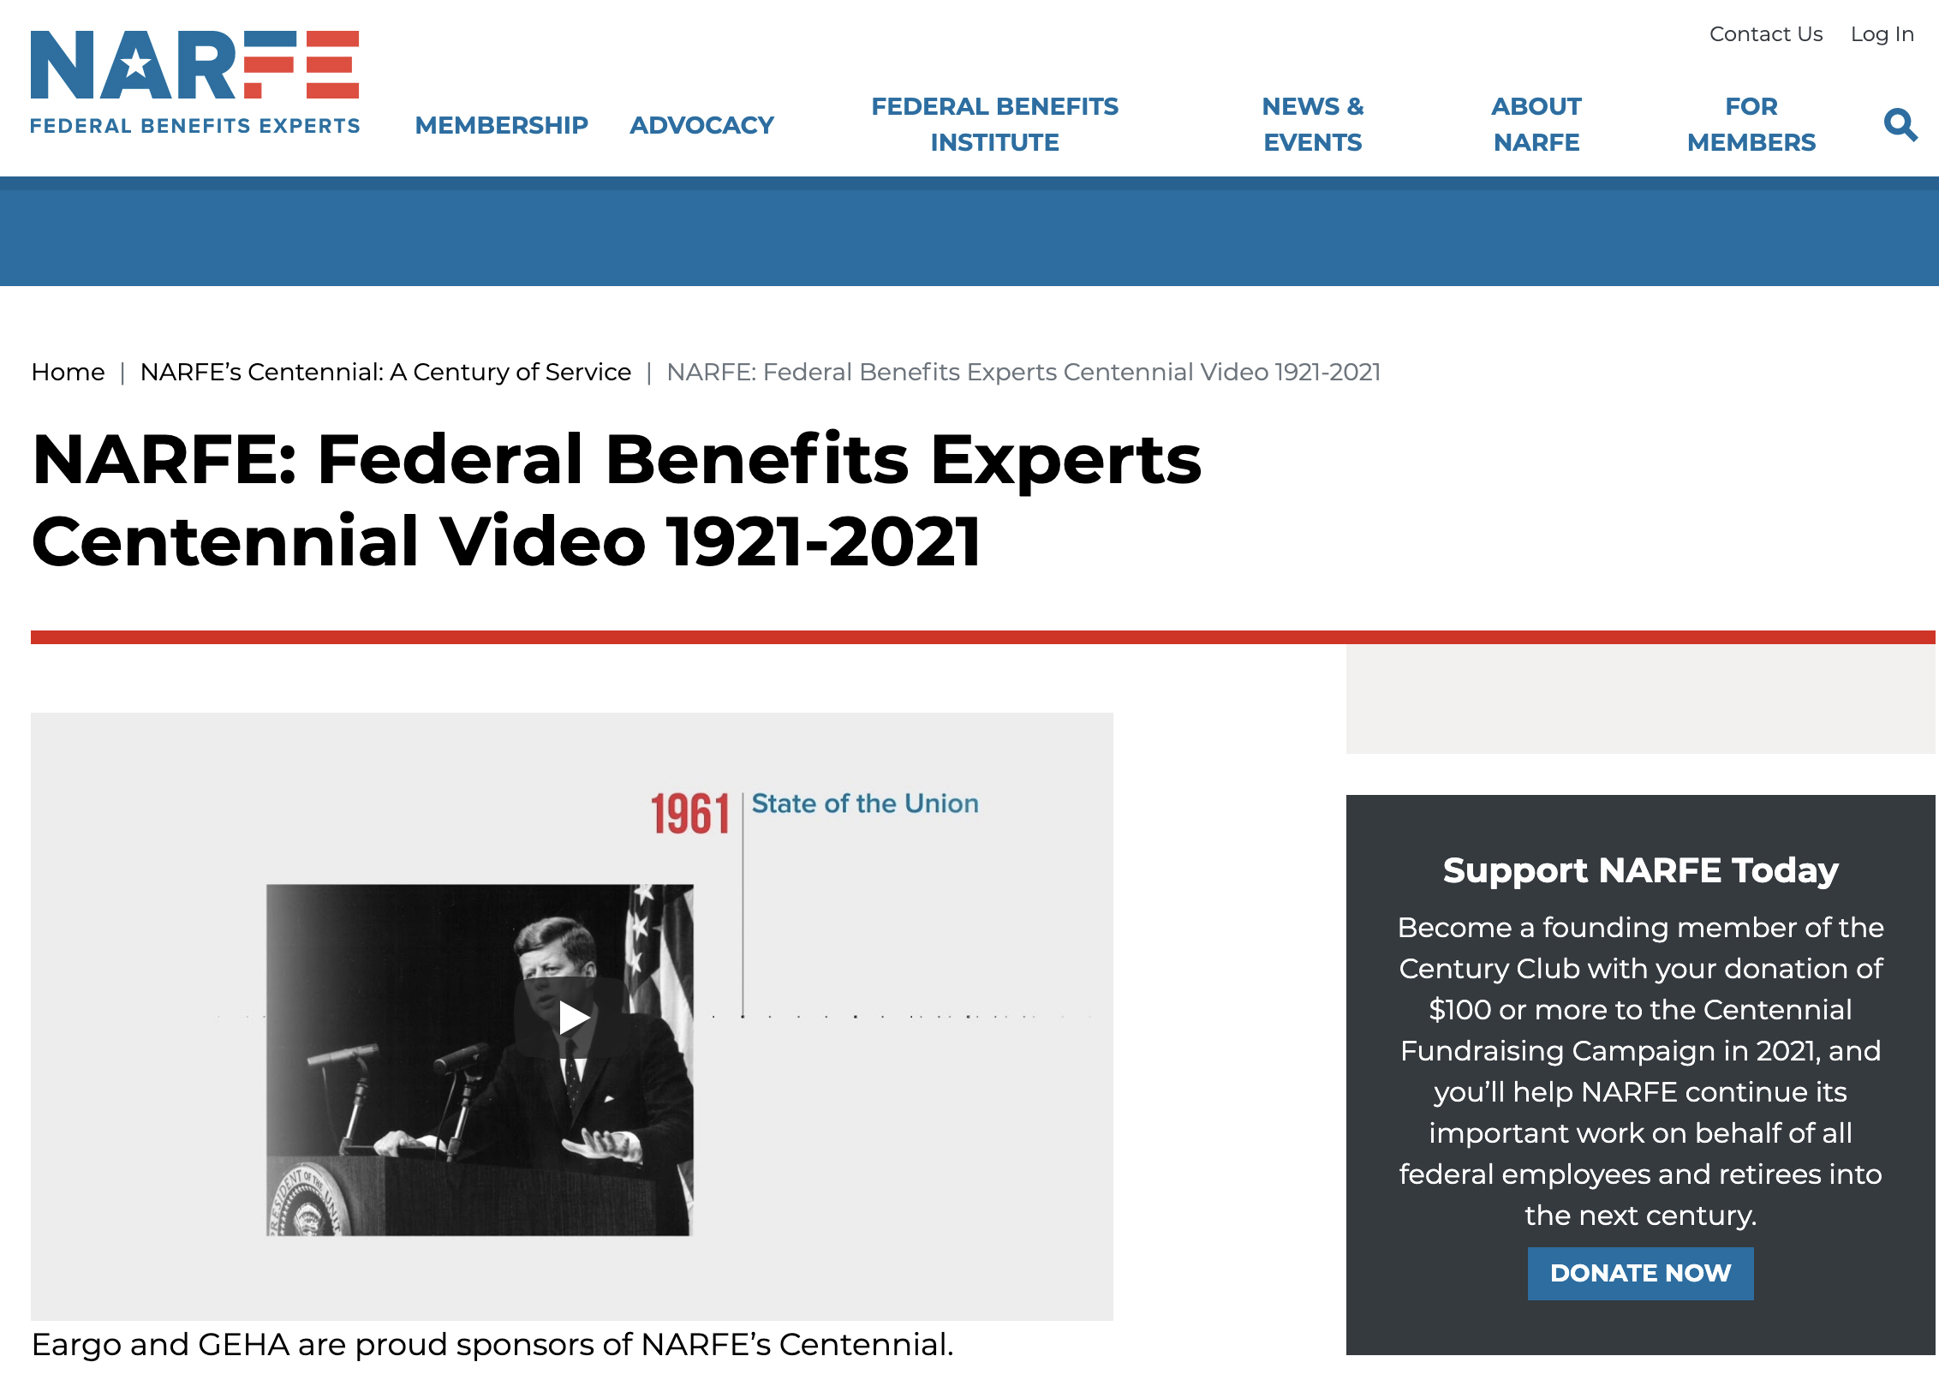
NARFE 2021
Centennial

Slide 10
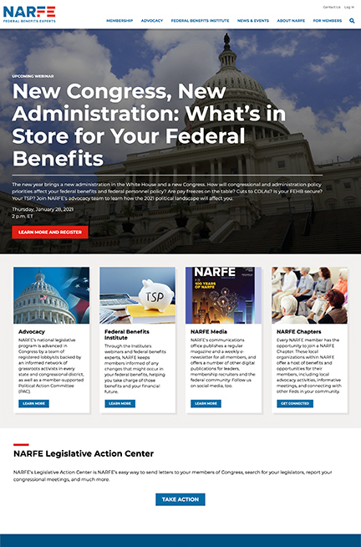
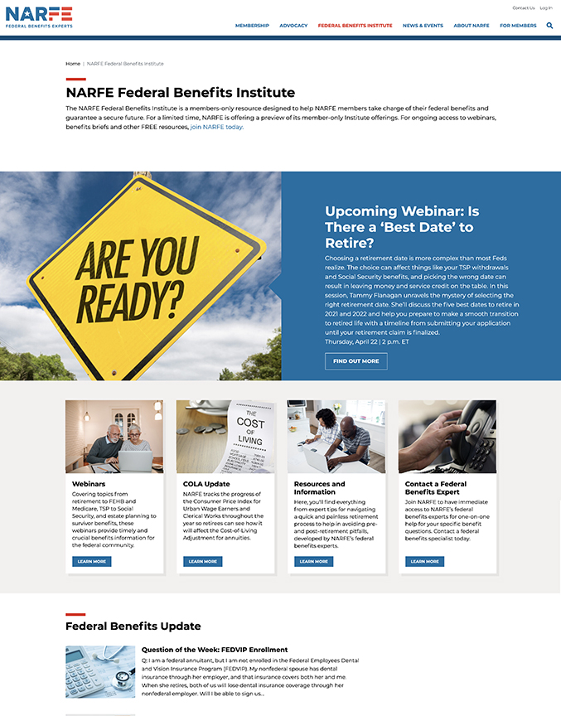
NARFE 2021
New Website

Slide 11
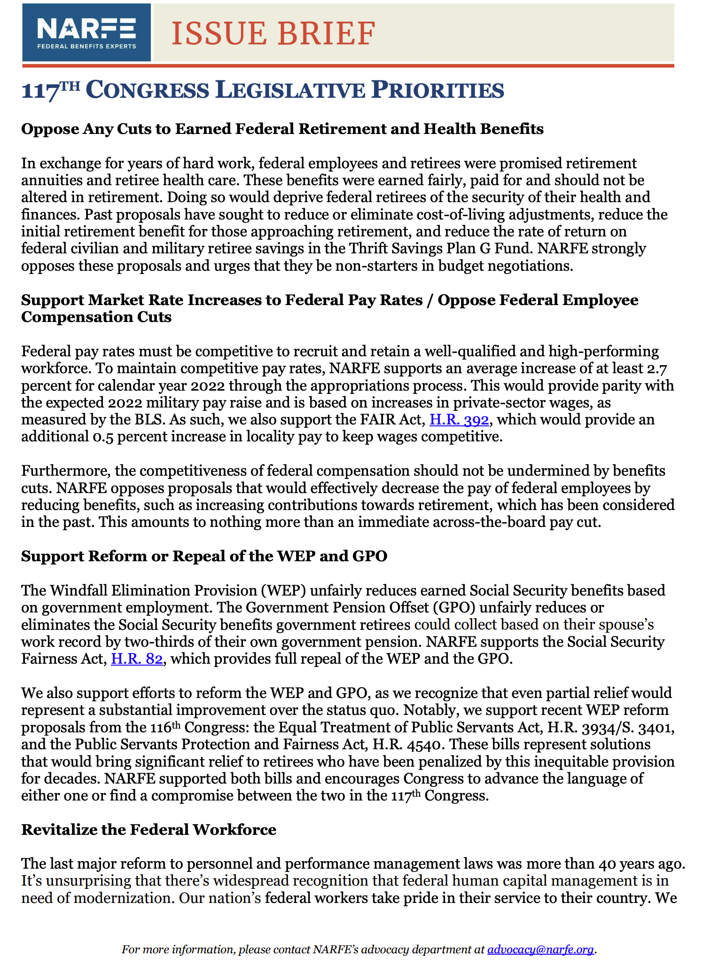
NARFE 2021
New Congress and Administration
Federal Benefits Institute

Slide 12
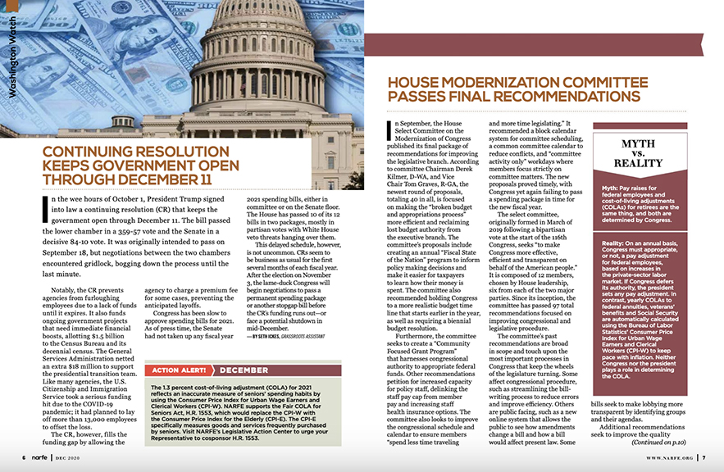
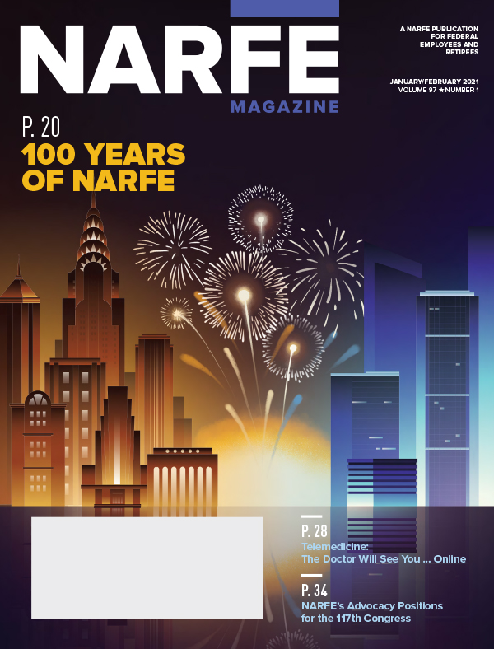
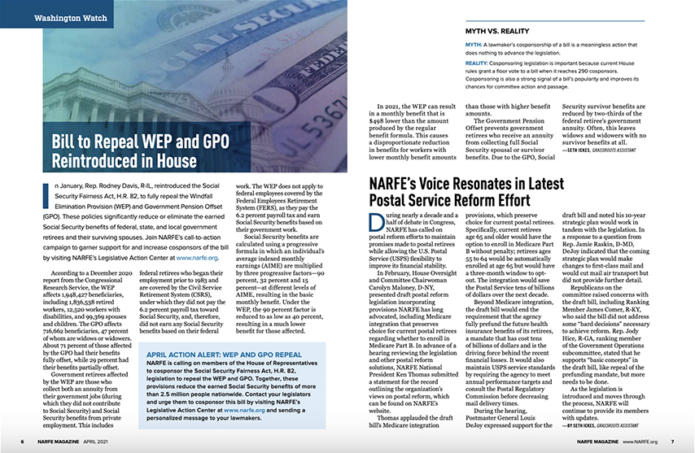
NARFE 2021
Magazine Refresh
Old Inside Spread Design
Old Nameplate Design
New Nameplate Design
New Inside Spread Design

Slide 13
Thank You!
Presented by
Barb Sido, CAE
execdir@narfe.org

